Slide 1
Multiplication Law of Probability for Independent Events

Slide 2

Consider drawing one ball from each of the urn below:
Urn X
Urn Y
Do you think the colour of the ball drawn from urn Y is affected by the colour of the ball drawn from urn X?
Yes / No

Slide 3
Consider drawing one ball from each of the urn below:
Urn X
Urn Y
Event A =
a blue ball is drawn from urn X
Event B =
a yellow ball is drawn from urn Y
The occurrence of event A does NOT affect the occurrence of event B.
Events A and B are independent events.

Slide 4
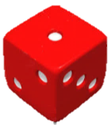
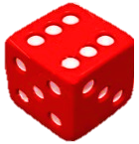

In throwing two dice once:
‘1’ shows up in dice X.
Event A:
‘6’ shows up in dice Y.
Event B:
Are events A and B independent?
Yes, the result of dice X does not affect the result of dice Y.

Slide 5
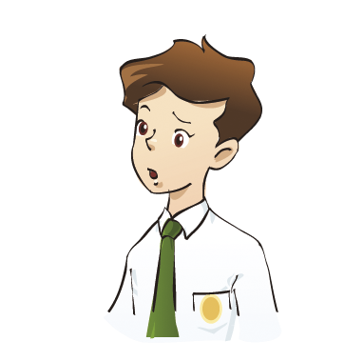
An urn contains 3 blue balls and 2 red balls.
Two balls are drawn one by one at random
without replacement:
Event C:
The first ball drawn is blue.
The second ball drawn is
also blue.
Event D:
Are events C and D independent?
No, P(the 2nd ball drawn is blue) is affected by the outcome of the first draw.

Slide 6
Follow-up question
Determine whether the following events are independent events.
(a) In throwing two dice once:
Event A = An odd number on the first dice
Event B = An even number on the second dice
Events A and B (are / are not ) independent events.
In drawing two cards one by one from a deck of 52 cards
without replacement:
Event A = The first card drawn is a Queen.
Event B = The second card drawn is also a Queen.
Events A and B (are / are not ) independent events.

Slide 7
After learning the concept of independent events, let us explore the relationship among P(A), P(B) and P(A ∩ B) for two independent events A and B.

Slide 8
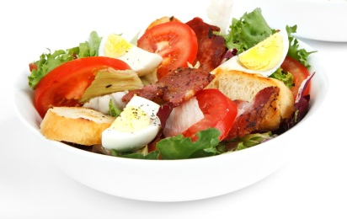

In a menu of a fast food shop,
Salads
1. Tuna salad
2. Caesar salad
3. Egg salad
Beverages
1. Tea
2. Coffee
These two events are independent.
Harry chooses tuna salad from the salad menu at random.
Harry also chooses tea from the beverage menu at random.
P(tuna salad) =
P(tea) =

Slide 9
Possible salad and beverage combinations:
Tuna salad and Tea
Tuna salad
Caesar salad
Egg salad
Tea
Coffee
Tuna salad and Coffee
Caesar salad and Tea
6 possible outcomes
in total
Tea
Coffee
Caesar salad and Coffee
Egg salad and Tea
Tea
Coffee
Egg salad and Coffee
∴ P(tuna salad and tea) =
P(tuna salad) = , P(tea) =
How does P(tuna salad and tea) relate to P(tuna salad)
and P(tea)?
P(tuna salad and tea)
= P(tuna salad) × P(tea)

Slide 10
In general,
if A and B are two independent events, then
P(A ∩ B) = P(A) × P(B).
In fact, this relationship is the multiplication law of probability for independent events, which can be extended as follows:
If A₁, A₂, … , A_{n} are independent events, then
P(A₁ ∩ A₂ ∩ … ∩ A_{n} ) = P(A₁) × P(A₂) × … × P(A_{n}).

Slide 11

In a shooting game, the probability for Cathy to hit the target in each shot is 0.7. Assume that each shot by Cathy is independent. If Cathy makes
3 shots, find the probabilities that
all the shots hit the target,
exactly one shot hits the target,
at least one shots hit the target.
Let H stand for the target is hit.
(a) P(all the shots hit the target)
= P(HHH)
= 0.7 × 0.7 × 0.7
= 0.343

Slide 12


(b) P(exactly one shot hits the target)
= P(HH′H′) + P(H′HH′) + P(H′H′H)
= 0.7 × 0.3 × 0.3 + 0.3 × 0.7 × 0.3 + 0.3 × 0.3 × 0.7
= 0.189
(c) P(at least one shots hit the target)
= 1 − P(all the shots do not hit the target)
= 1 − 0.3 × 0.3 × 0.3
= 0.973

Slide 13
Follow-up question
In throwing two dice once, what is the probability that the first number is even and the second number is ‘6’?
Event A = the first number is even
Event B = the second number is ‘6’
∵ A and B are independent events.
The 1st number obtained will not affect the 2nd number obtained.
∴ P(A and B) = P(A) × P(B)

Slide 14
Follow-up question
In a city, 40% of the citizens are female. If three citizens are chosen at random from the city, find the probabilities that
(a) three male are chosen,
(b) at least one female is chosen,
(c) exactly one female is chosen.
Let M stand for a male is chosen and F for a female is chosen.
(a) P(three male are chosen)
= P(MMM)
= 0.6 × 0.6 × 0.6
= 0.216

Slide 15
(b) P(at least one female is chosen)
= 1 − P(three male are chosen)
= 1 − 0.216
= 0.784
(c) P(exactly one female is chosen)
= P(FMM) + P(MFM) + P(MMF)
= 0.4 × 0.6 × 0.6 + 0.6 × 0.4 × 0.6 + 0.6 × 0.6 × 0.4
= 0.432

